Slide 1


Department of Artificial Intelligence and Data Science
Real - Time Behavioural
Authentication System
Guruprasath P 221801014
Priadharshni P 221801039
Vijay Kumar V 221801505
Mr. Thiyagarajan G - M.E.,
Mr. Suresh Kumar S - M.E.,Ph.D.,

Slide 2
Problem Statement and Motivation
THE SECURITY CHALLENGE
Passwords can be stolen, guessed, or shared
Multi-factor auth (MFA) can be bypassed
One-time verification doesn't detect session hijacking
No way to detect if authorized user is compromised
OUR SOLUTION
Continuous authentication through behavioral patterns
Unique typing rhythms
Mouse movement characteristics
Application usage patterns
Real-time anomaly detection
End Sem
Department of Artificial Intelligence and Data Science
2

Slide 3
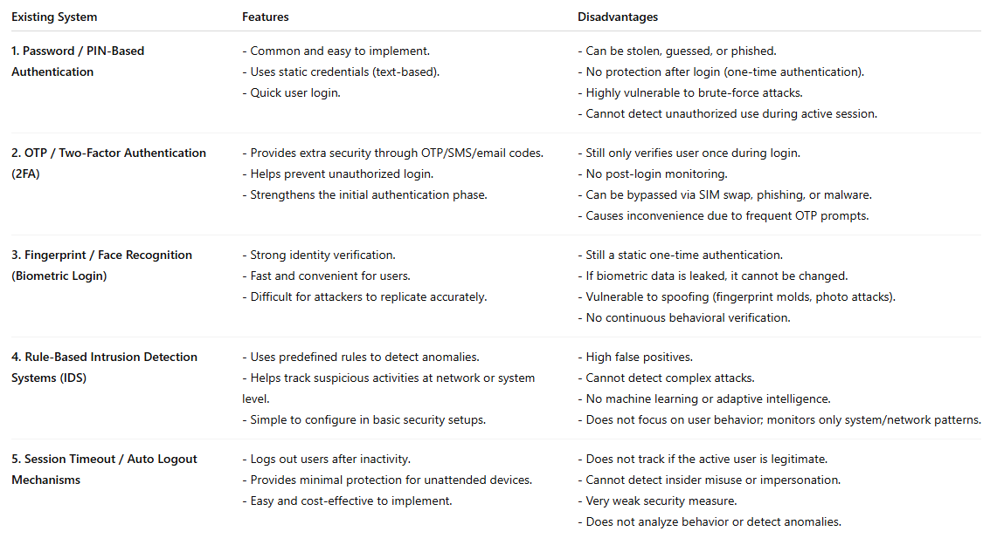
Existing System
End Sem
Department of Artificial Intelligence and Data Science
3

Slide 4

Objective
Develop a continuous authentication system that monitors user behavior in real-time
Build predictive models to detect anomalous behavior with high accuracy.
Create an adaptive system that learns and evolves with user behavior patterns
Ensure privacy and security of collected data
End Sem
Department of Artificial Intelligence and Data Science
4

Slide 5
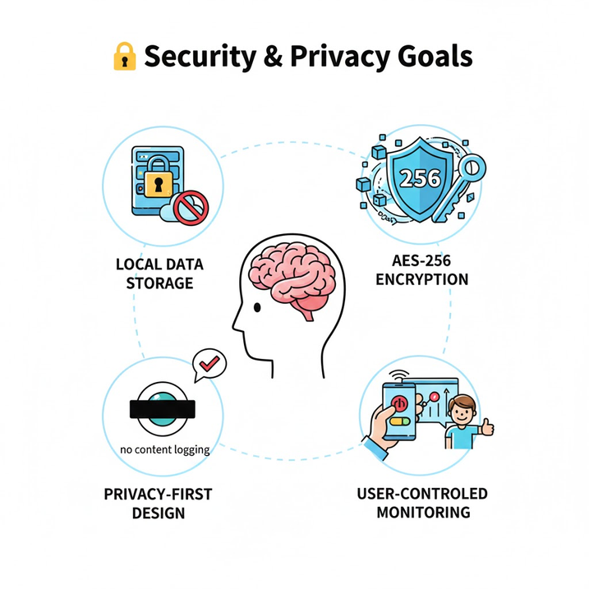
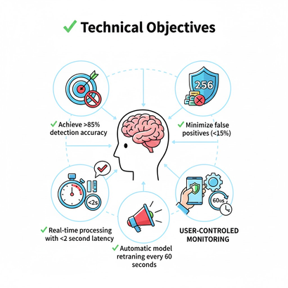
Objective
Technical Objective
Achieve >85% detection accuracy
Minimize false positives (<15%)
Real-time processing with <2 second latency
Automatic model retraining every 60 seconds
Provide actionable security alerts
Security & Privacy Concerns
Local data storage (no cloud transmission)
AES-256 encryption for sensitive data
Privacy-first design (no content logging)
User-controlled monitoring
End Sem
Department of Artificial Intelligence and Data Science
5

Slide 6
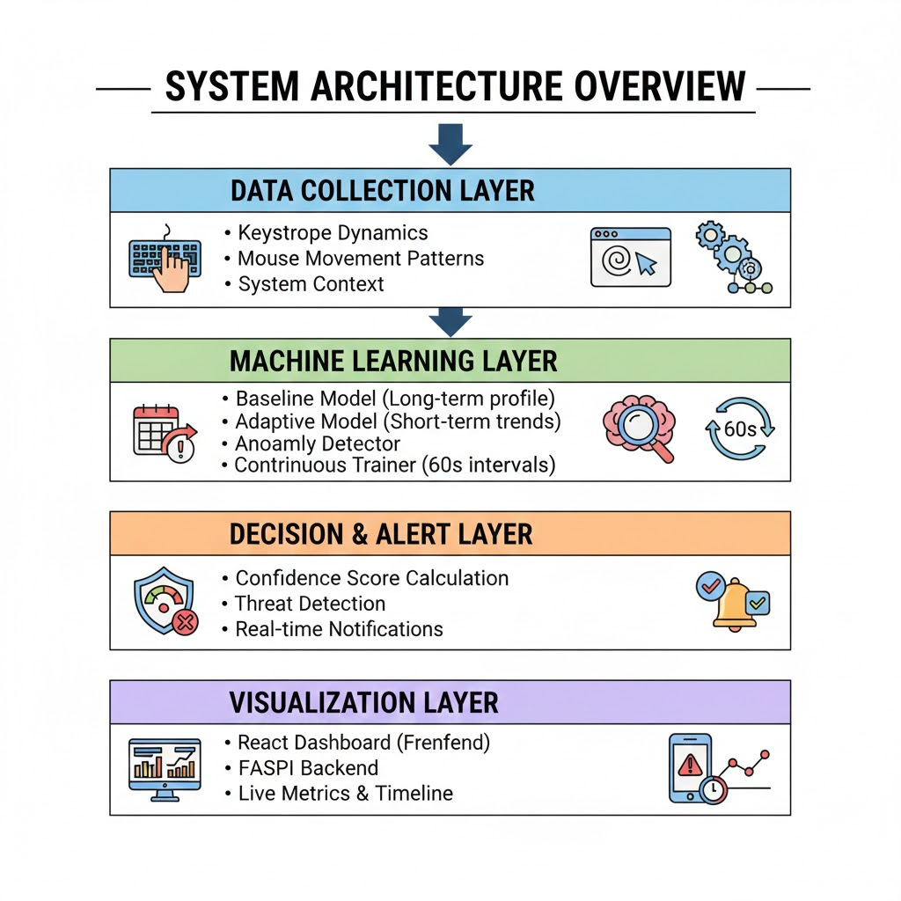
System
Architecture
End Sem
Department of Artificial Intelligence and Data Science
6

Slide 7
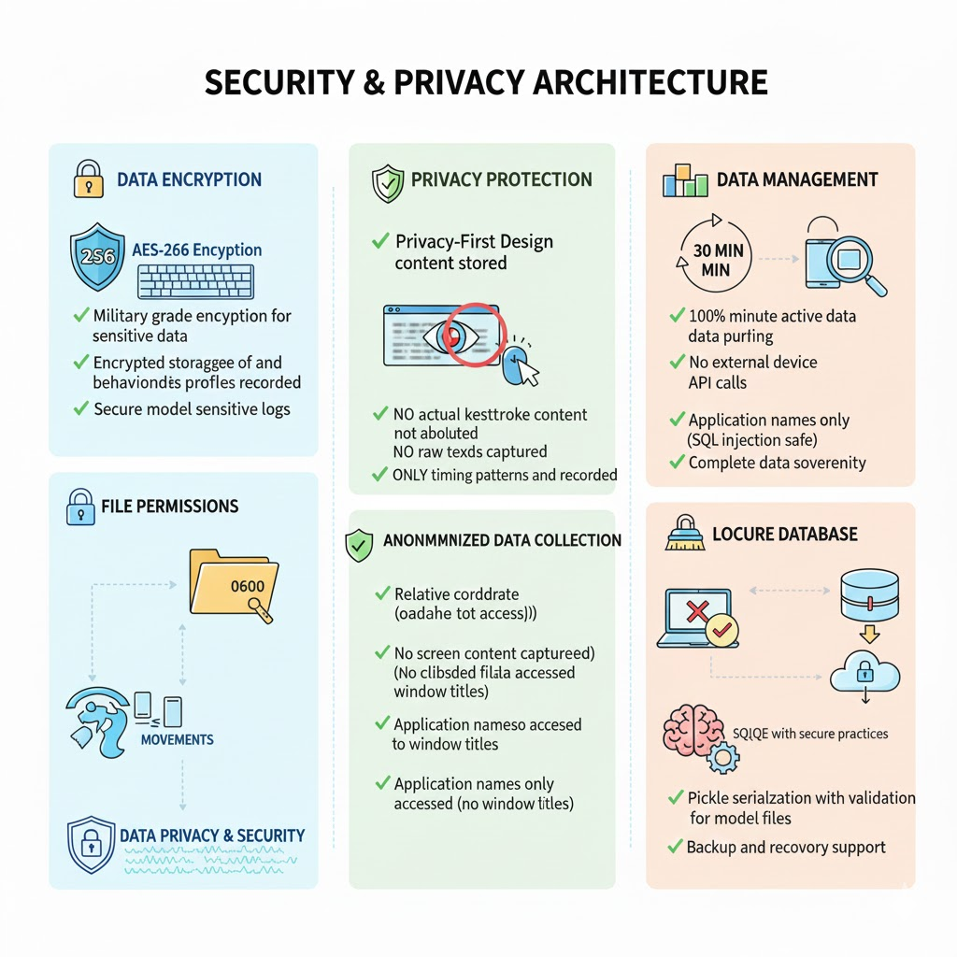
Secure architecture ensuring encrypted data, minimal collection, and strict privacy protection.
End Sem
Department of Artificial Intelligence and Data Science
7

Slide 8
Privacy Protection
NO actual keystrokes stored (only timing/patterns)
NO mouse coordinates (relative movements only)
NO application content captured
AES-256 encrypted storage
Local-only processing
End Sem
Department of Artificial Intelligence and Data Science
7

Slide 9
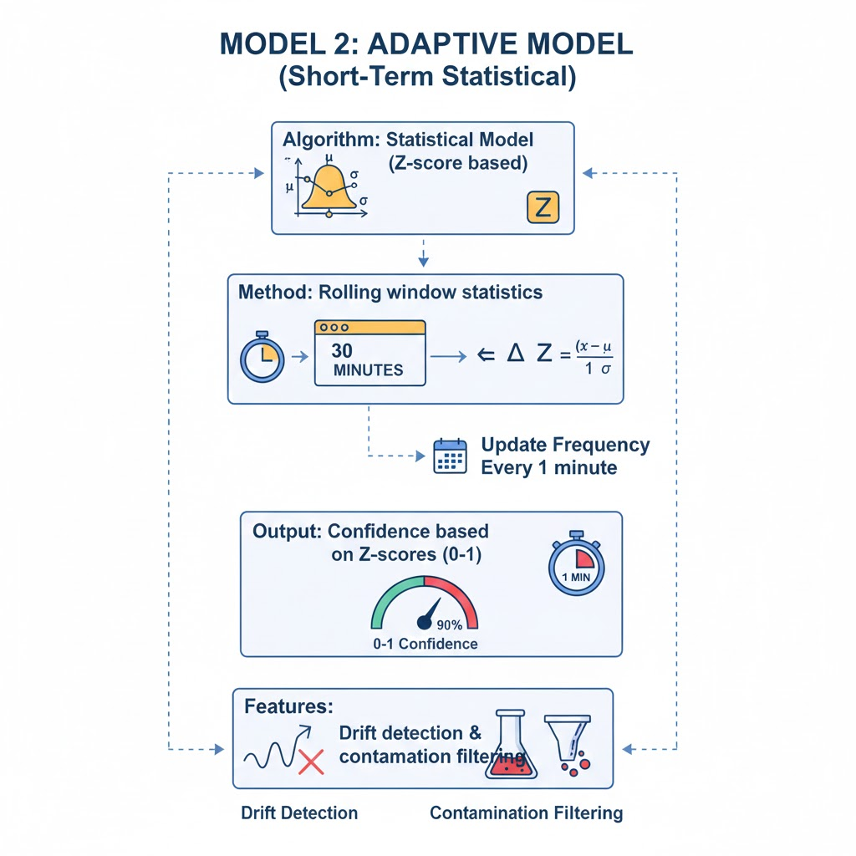
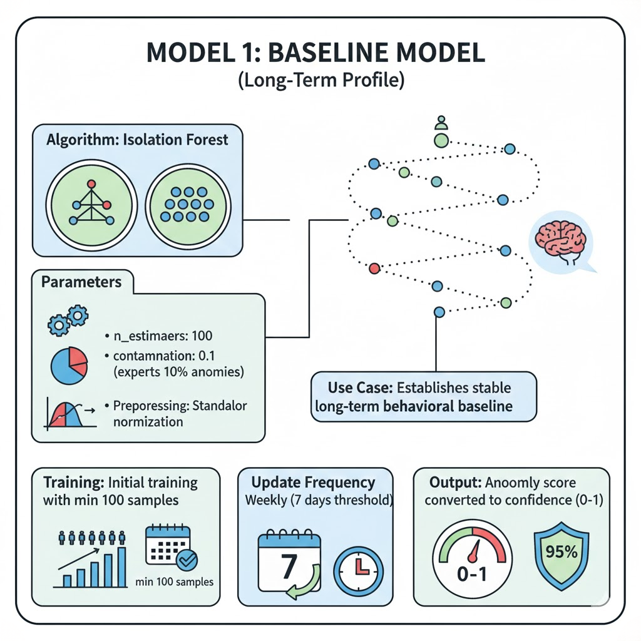
End Sem
Department of Artificial Intelligence and Data Science
7

Slide 10
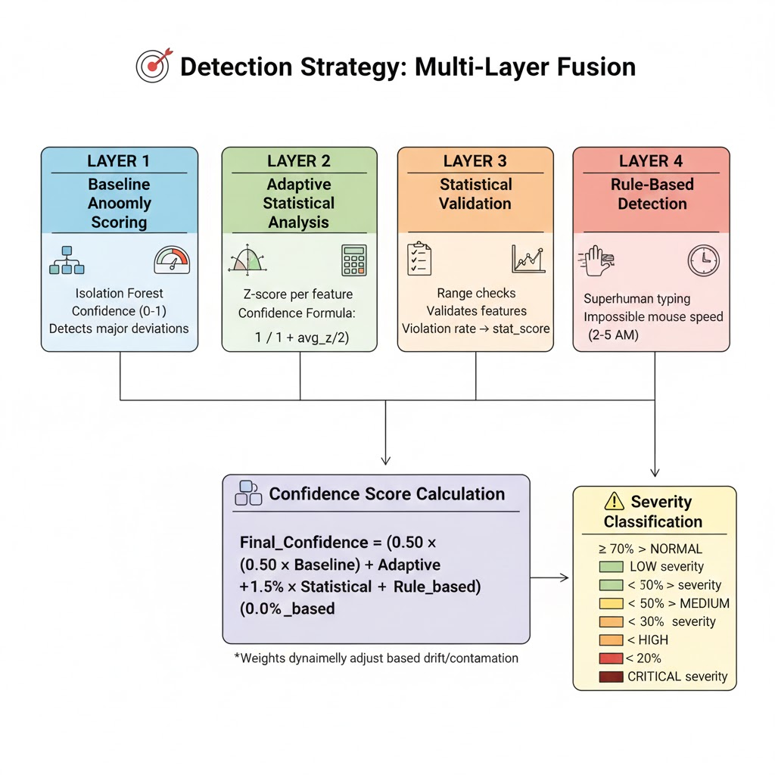
Anomaly Detection Methodology
End Sem
Department of Artificial Intelligence and Data Science
8

Slide 11
Thank You
End Sem
Department of Artificial Intelligence and Data Science
9

